Slide 1
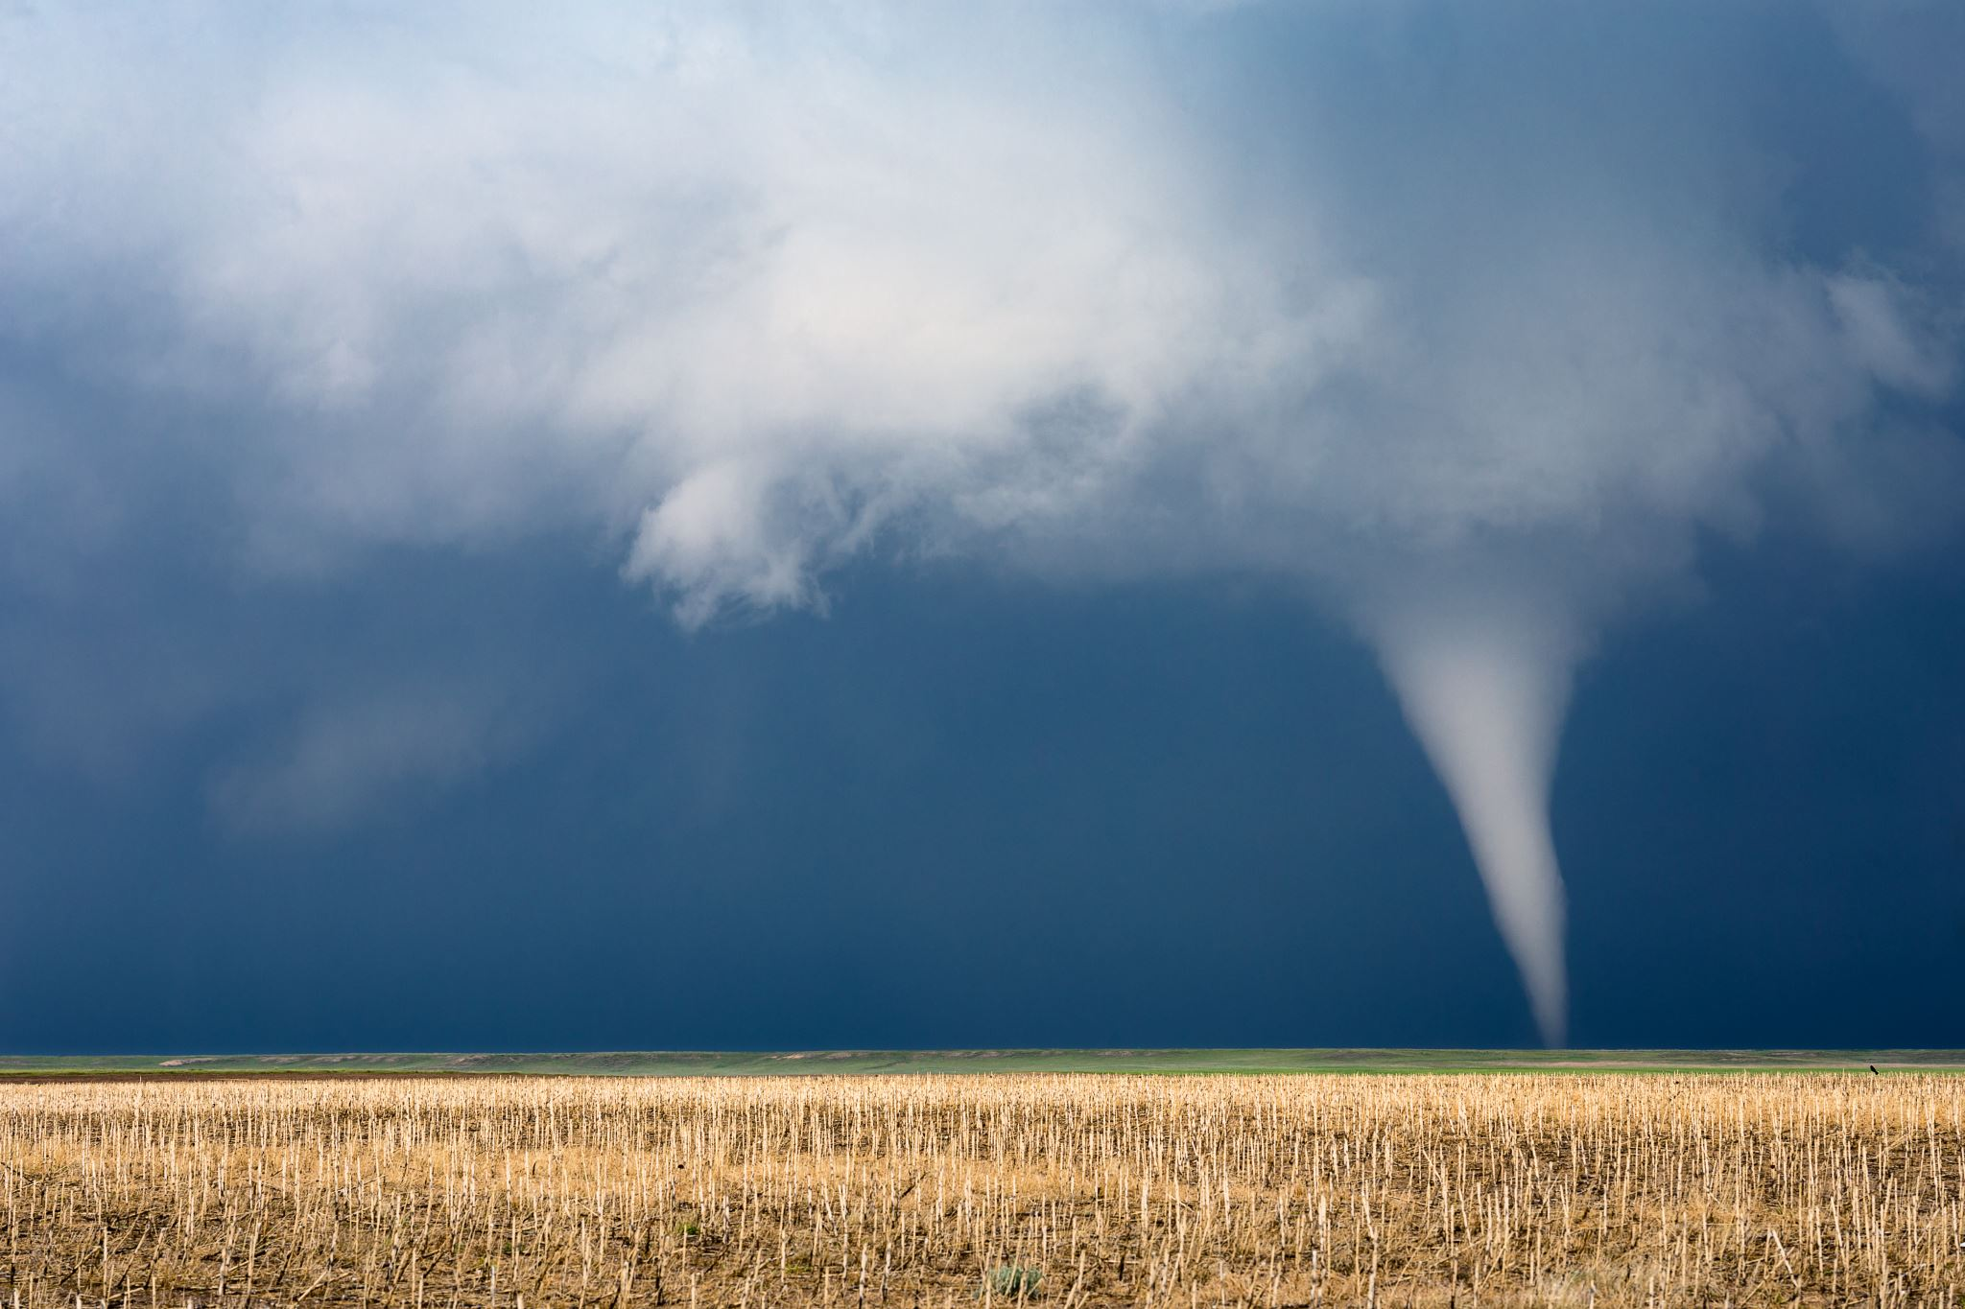
United States Natural Disasters
Presentation by:
Edward Hraba

Slide 2
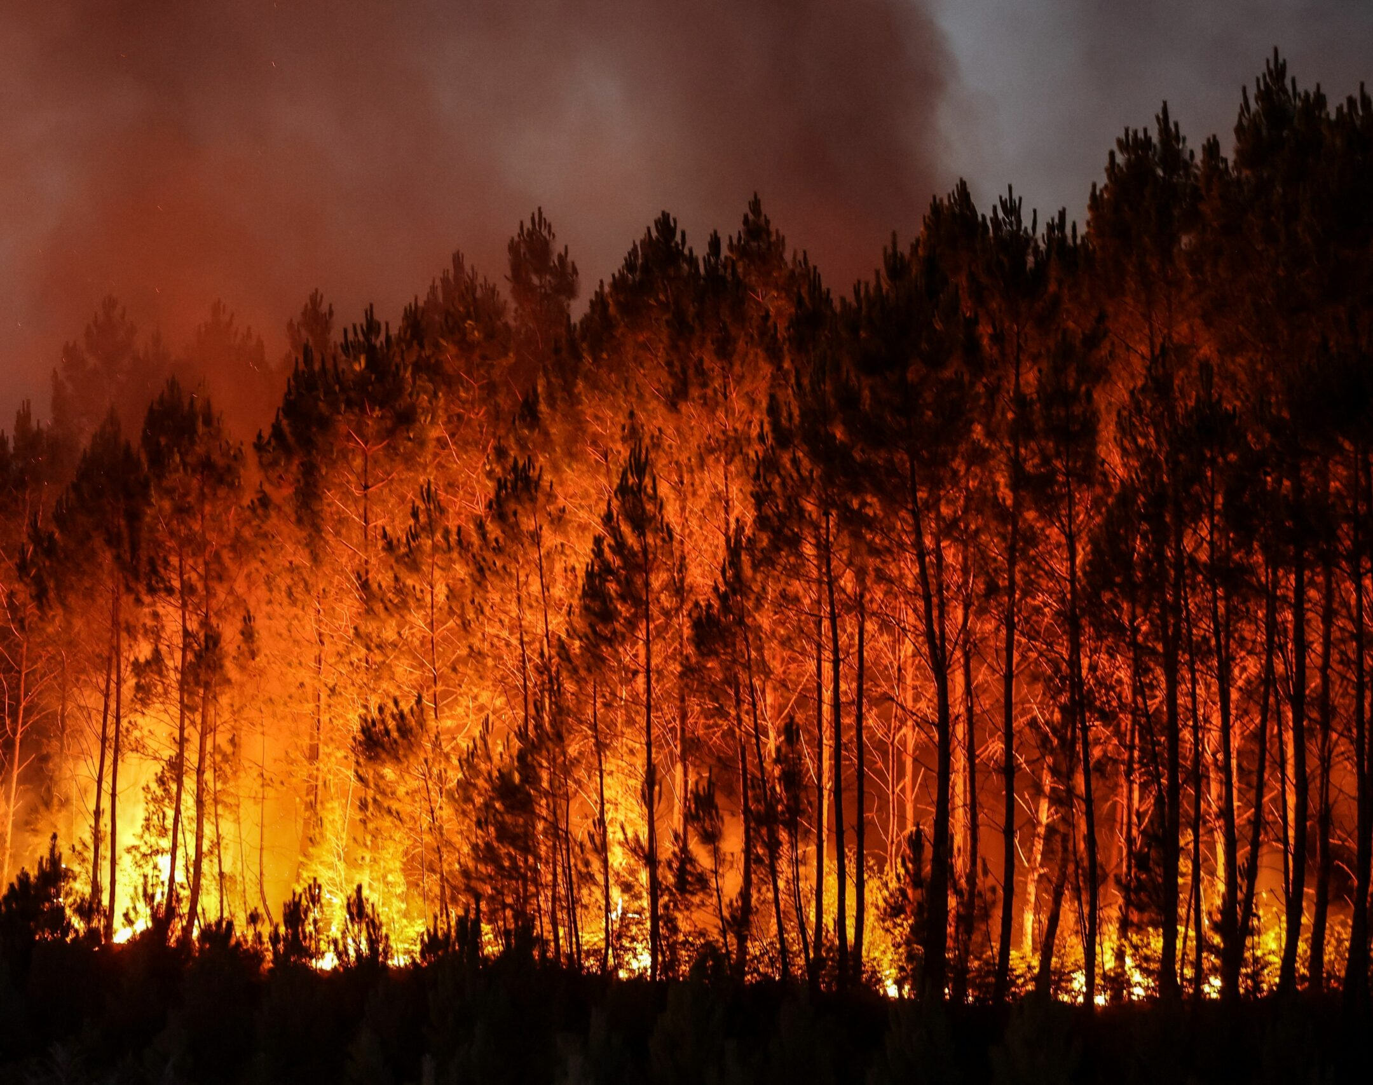
Why I chose this topic
With family in North Carolina and California that have been affected by natural disasters
Natural disaster relief provided through military experience
Natural disaster impact on home insurance prices
Notes:
In my time in the Marine Corps, I was in a unit that traveled the pacific and we provided relief to countries that were affected by natural disasters
Due to my experience with natural disasters I had a general curiosity o the impact natural disasters had on home insurance prices

Slide 3
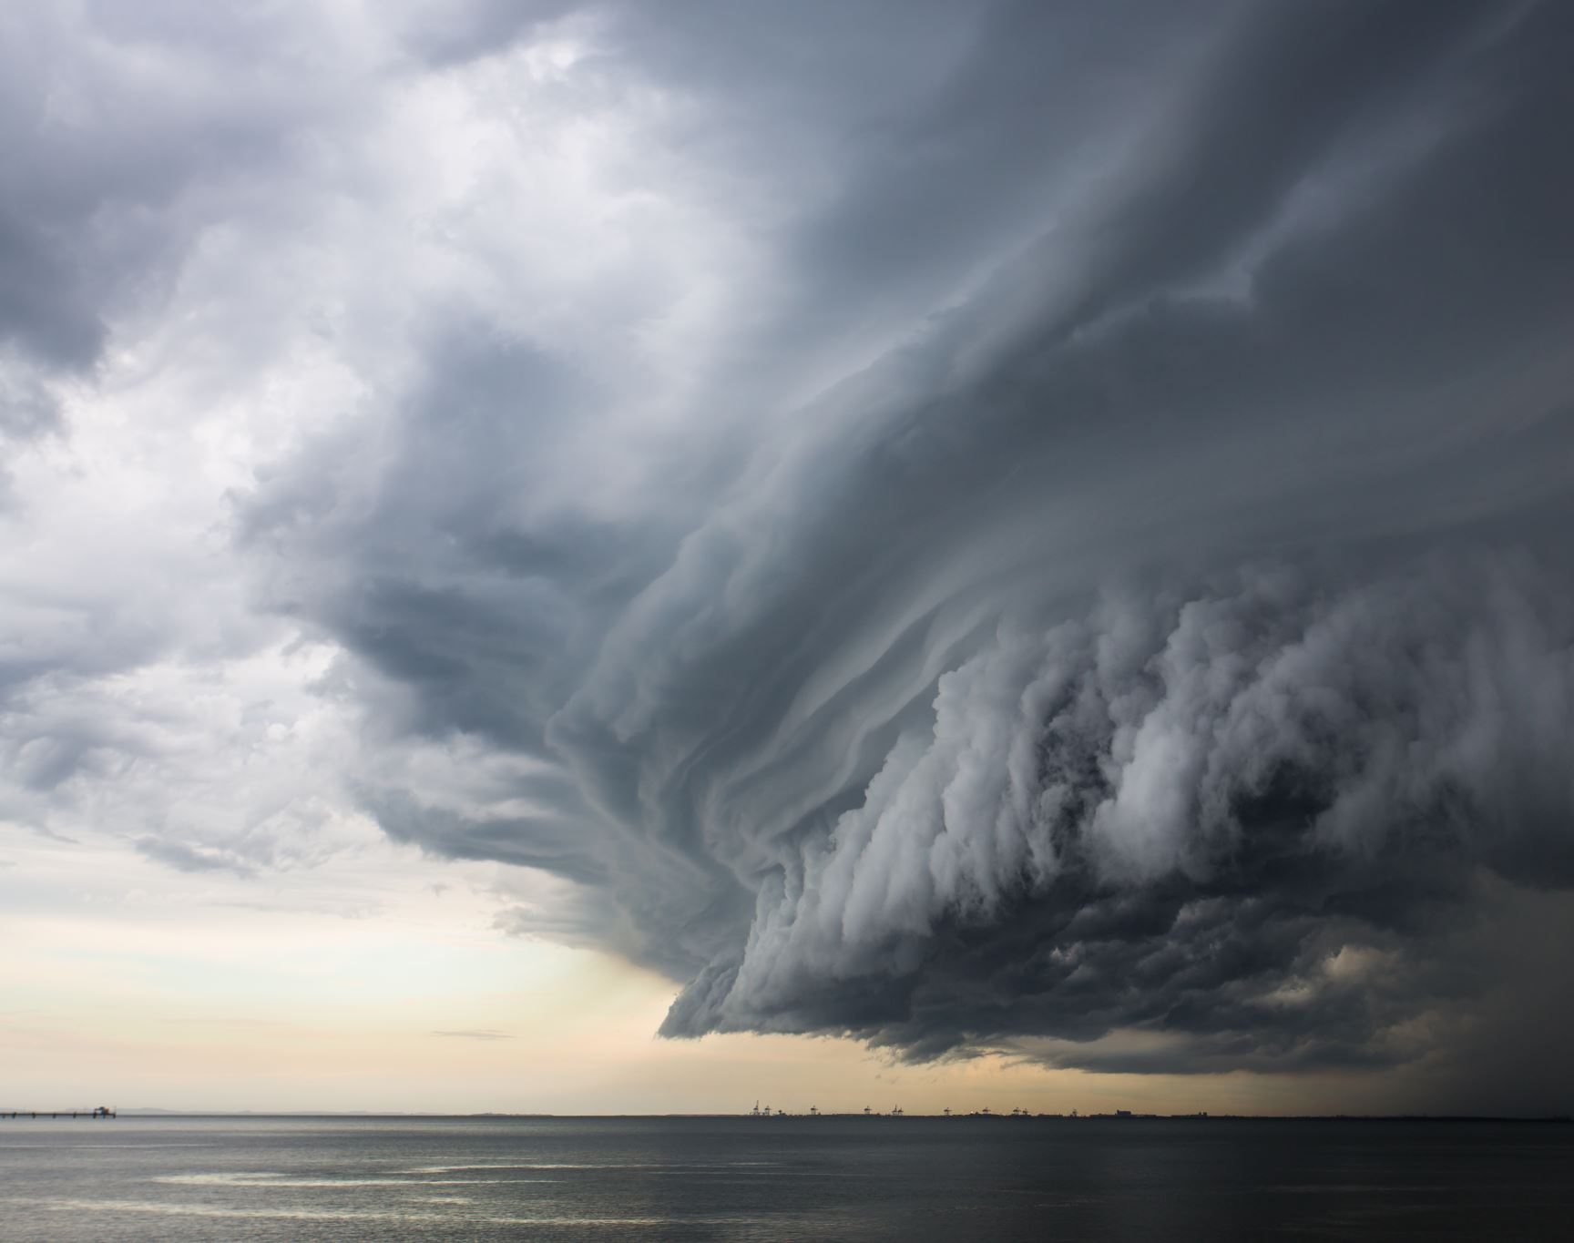
United States Natural Disasters
What will be covered in this presentation?
What is the most common type of natural disaster in America?
States with frequent disasters: How do the insurance rates look in these states compared to the lower risk states?
How do natural disasters affect population?
Are there any high risk locations that have not been hit with a disaster for a significant amount of time? Are there any time patterns that can indicate when a disaster will hit?
Data was gathered on 08/05/2024 any disasters since then will not be calculated

Slide 4

Population/Disaster Type

Slide 5
Insurance

Slide 6
Days since last disaster

Slide 8
disasters per 1000 sq miles

Slide 9
Page 2

Slide 10
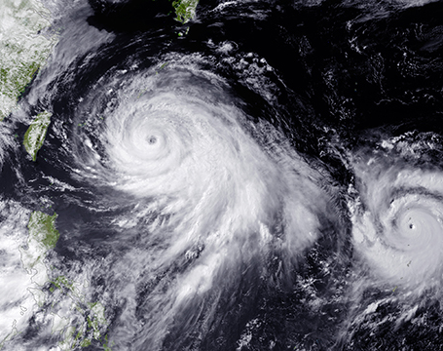
In Conclusion
Fires or wildfires were the most common type of disaster in America
Insurance rates are directly affected by natural disasters the more disasters a state had the more the cost was in annual insurance
The number of natural disasters does not have an impact on the rise of population in high-risk states
Oklahoma was the 2nd highest state for natural disasters, and they had the highest number of days without a natural disaster at 80
Notes:
As you can see Fires account for 1298 of the disasters 454 more than the runner up Severe Storms
You can add up all disasters from hurricane down to drought and fires will still be 285 more than all those combined
On the next slide we will go into power bi for an in depth look of the insurance rates and populations and potential affect the disasters have on them

Slide 11
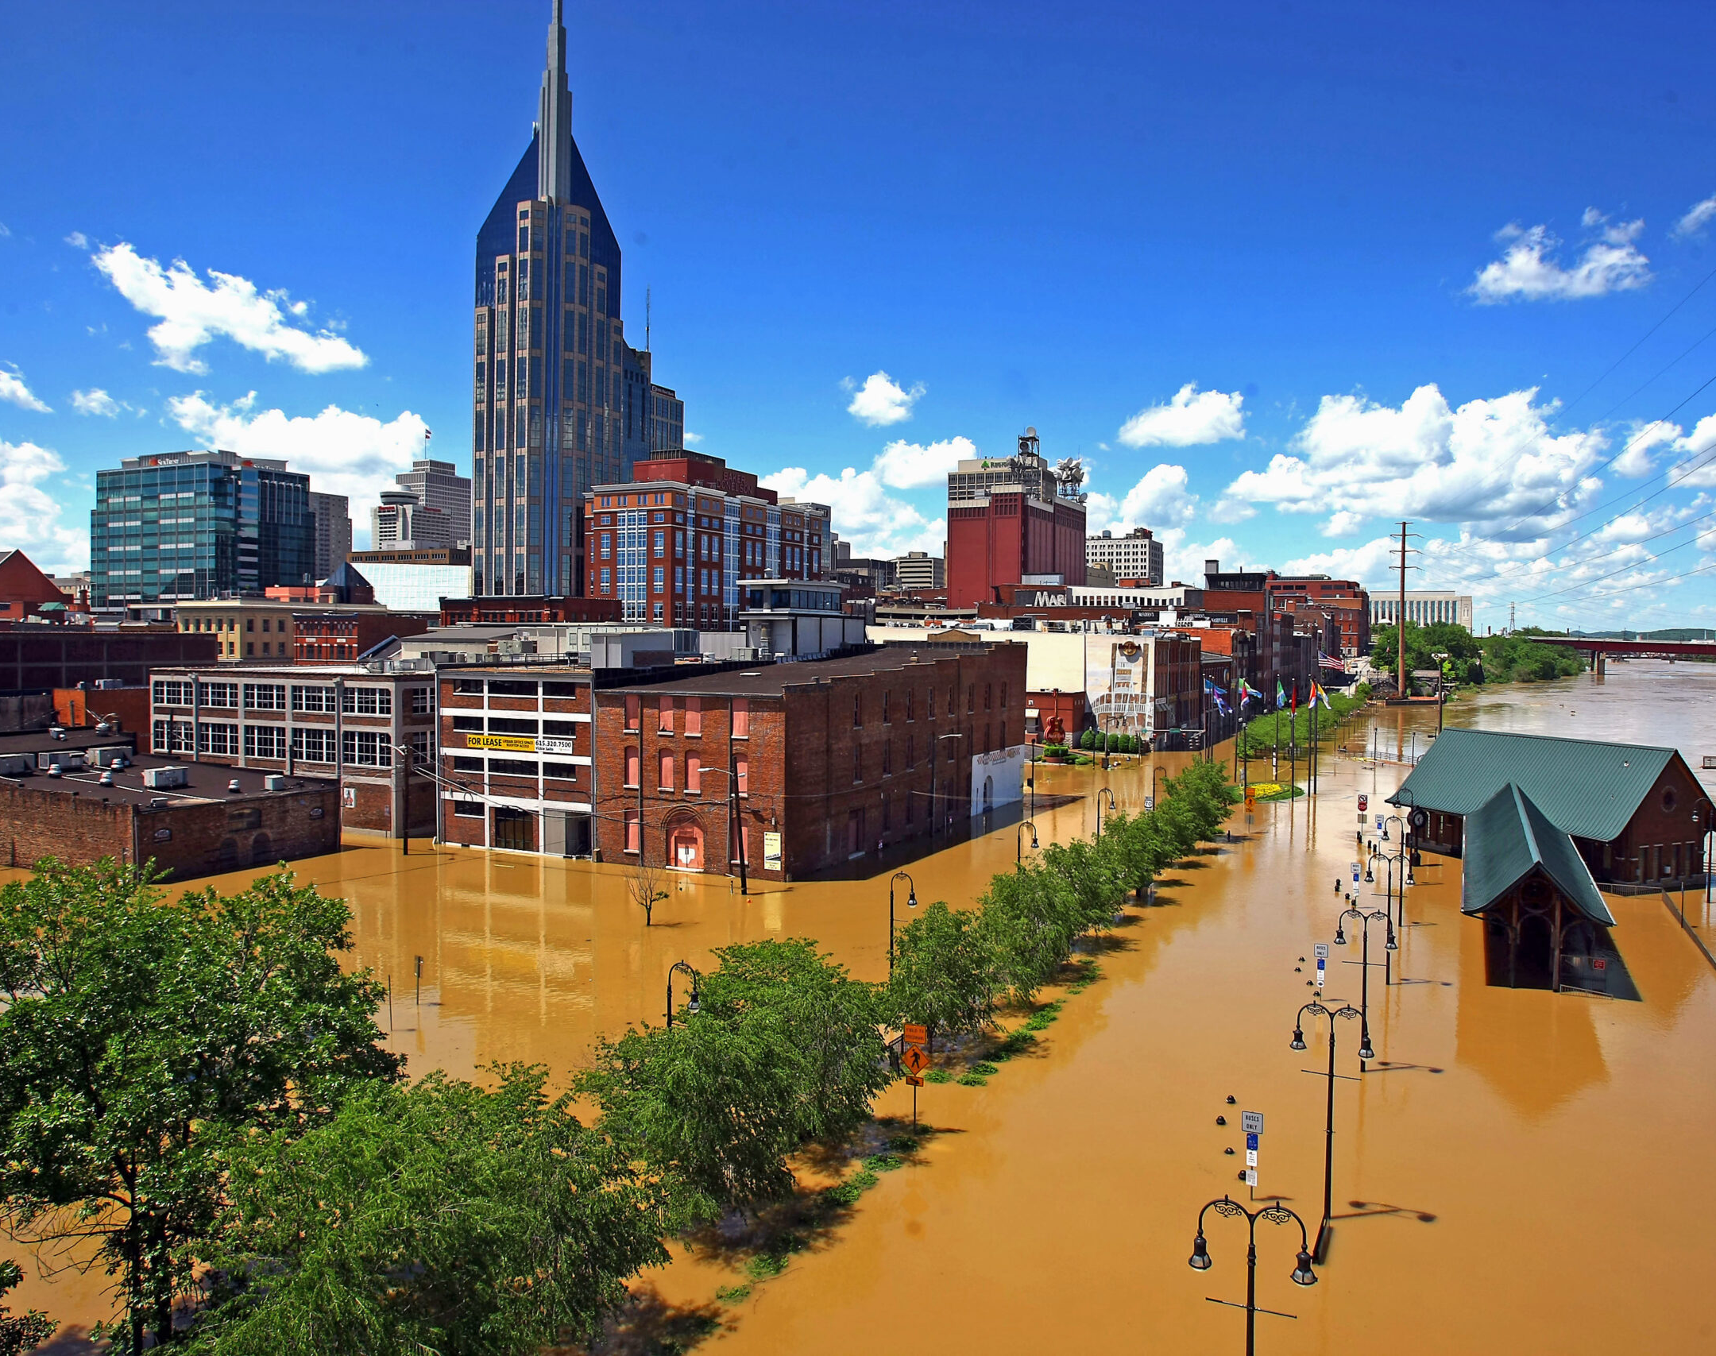
Data Sources
EM-DAT for natural disasters data: link: https://public.emdat.be/
FEMA for natural disasters : Link : https://www.fema.gov/disaster/declarations
census data link: https://data.census.gov/table
bankrate.com for home insurance rates : link : https://www.bankrate.com/insurance/homeowners-insurance/states/#home-insurance-rates-by-state
Insurance.com for home insurance rates: link :https://www.insurance.com/home-and-renters-insurance/home-insurance-basics/average-homeowners-insurance-rates-by-state#:~:text=higher%20when%20included.-,States%20with%20the%20highest%20home%20insurance%20rates,increase%20in%20home%20insurance%20costs

Slide 12
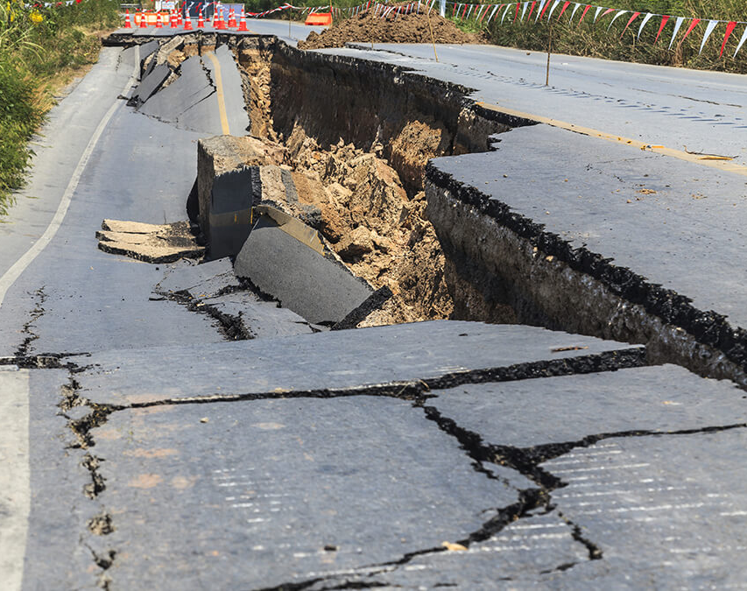
Thank you for your time
Please feel free to ask any questions

